Slide 1
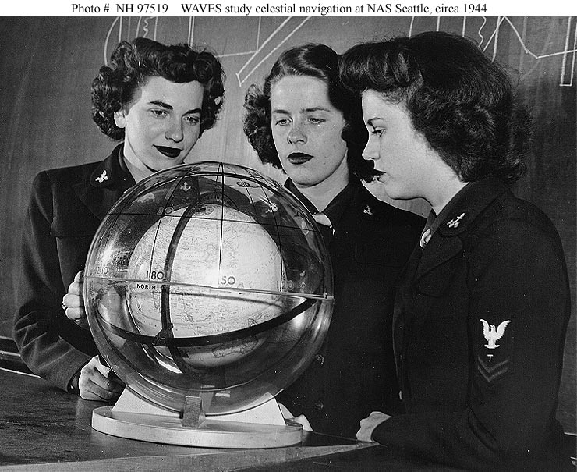
Celestial Navigation 101

Slide 2
Queue UP
Flash Demo SHA
  http://astro.unl.edu/classaction/animations/200level/siderealTimeAndHourAngleDemo.html
Vimeo for intermission
  http://vimeo.com/36141149

Slide 3
Celestial Navigation 101

Slide 4
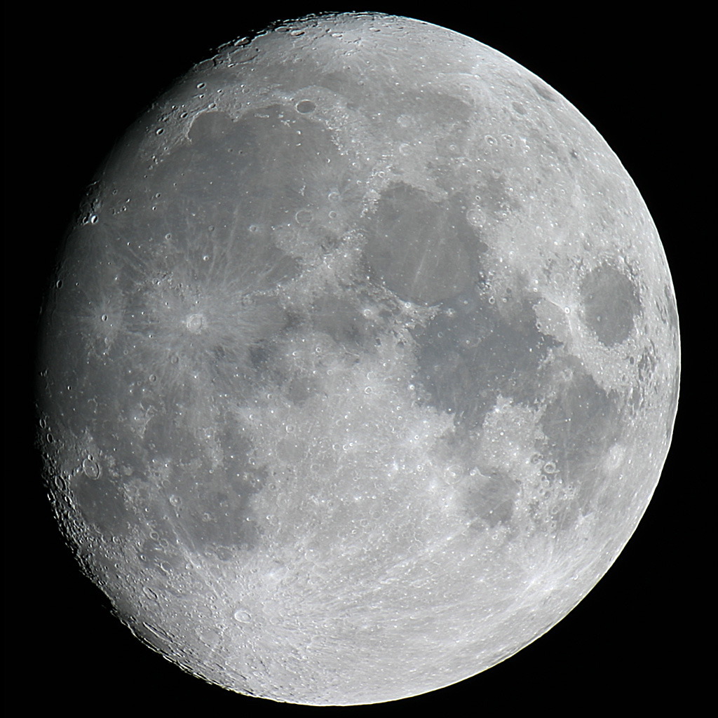
AGENDA
45 min lecture
Intermission
  Go outside
  Take some sights
Reduce sights
Lifeboat navigation

Slide 5
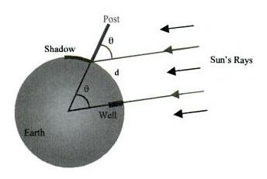
How it works

Slide 6
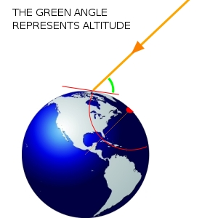
Circle of Position
horizon
Altitude
GP
Circle of Position

Slide 7
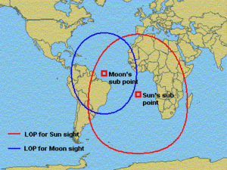
Two body FIX

Slide 8
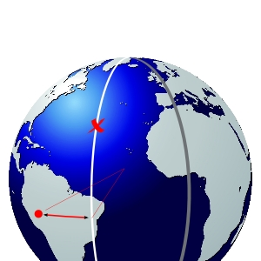
Global Position
celestial body’s geographic position
point on earth where celestial body is directly overhead
M
Prime meridian
GP
LHA

Slide 9
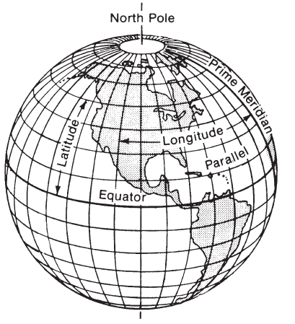
Latitude & Longitude
Latitude
    Natural
    defined by poles, equator
Longitude
    arbitrary
    relative to Greenwich
    Time keeping problem

Slide 10
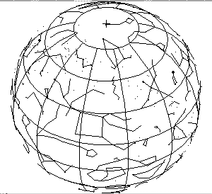
Celestial Sphere
Declination
  Celestial Equator
  Sidereal Hour Angle
  1st point of Aries

Slide 11
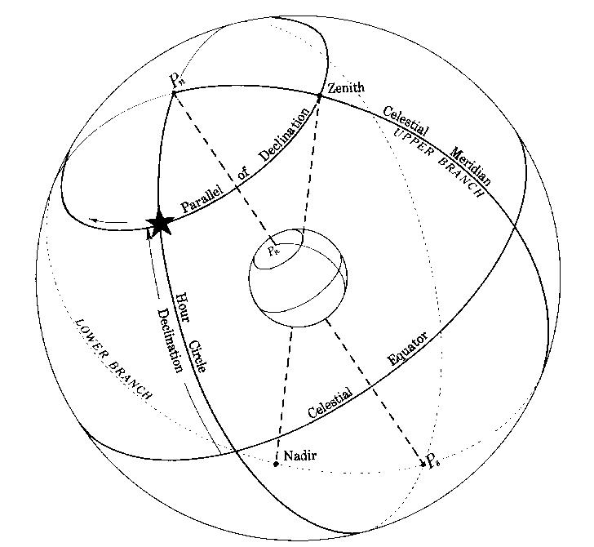
Declination

Slide 12
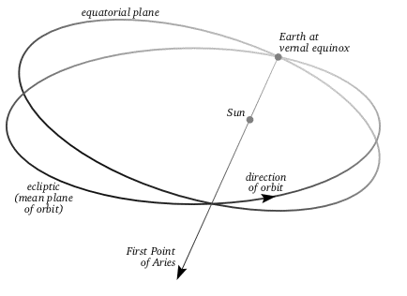
First Point of Aries 
Sun at the Vernal Equinox
Now located in Pisces
  procession of the equinox
Notes:
Earth wobbles like a top, with a period of approximately 26,000 years

Slide 13
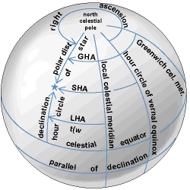
Hour Angles
Sidereal Hour Angle (SHA)
   west to 
Right Ascension (RA)
   east to 
Greenwich Hour Angle (GHA)
  G west to 
Local Hour Angle (LHA)
  observer (M) west to 
Longitude
  G east/west to M
G

M

Slide 14
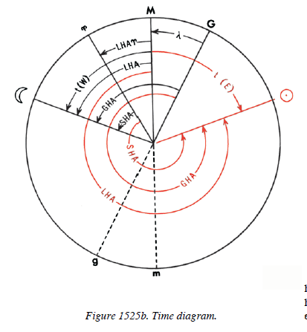
Time Diagram
M – observer’s meridian
G – Greenwich meridian
 - Aries
 - Moon
 - Sun

Ps
Notes:
Looking at South Pole.
Why? Sun, Moon, etc move clockwise on the Time Diagram

Slide 15
Flash Demo
http://astro.unl.edu/classaction/animations/200level/siderealTimeAndHourAngleDemo.html
Notes:
Everything I’ve so far I almost threw away when I saw this

Slide 16
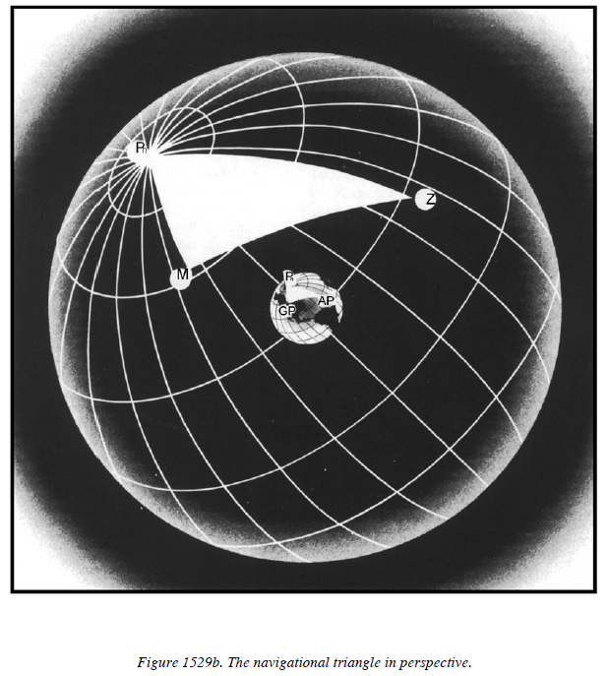
Bowditch – nav triangle
Co-latitude
Co-dec
Co-altitude
--- Latitude ---

Slide 17
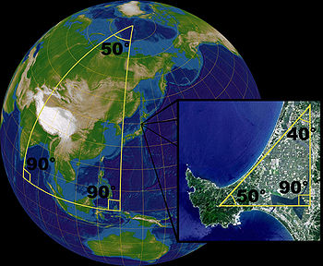
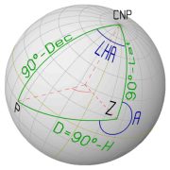
Navigational Triangle
Co-lat = 90-lat
Co-dec = 90-dec
Co-Altitude=90-Ho
GP

Slide 18
Pop Quiz
How Many Horizons are there?
  one
  two
  three
  four

Slide 19
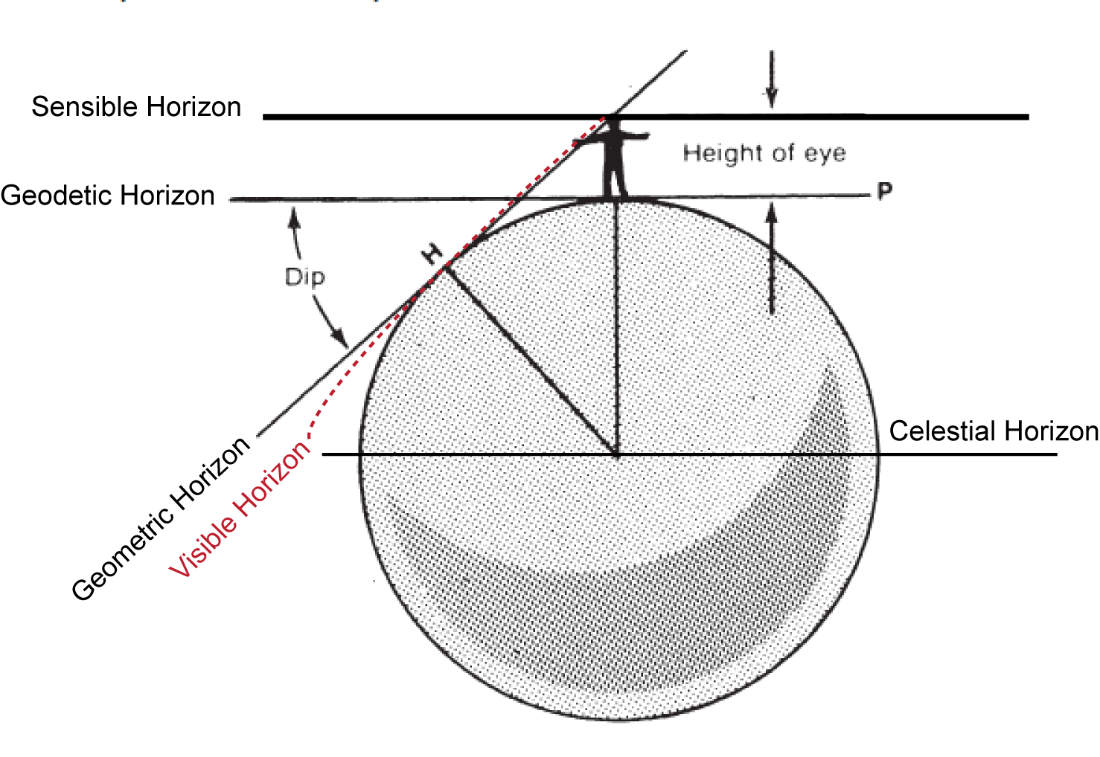
Five Horizons
Notes:
Celestial is what’s used
Diff between Geodetic and Sensible =HE – important for naval sextants, but not for bubble sextants like we’ll be using on our phones pods and pads.
Visible horizon (poorly drawn through no fault of my wife ;-) is Refraction – an important correction esp when bodies are low in the sky.

Slide 20
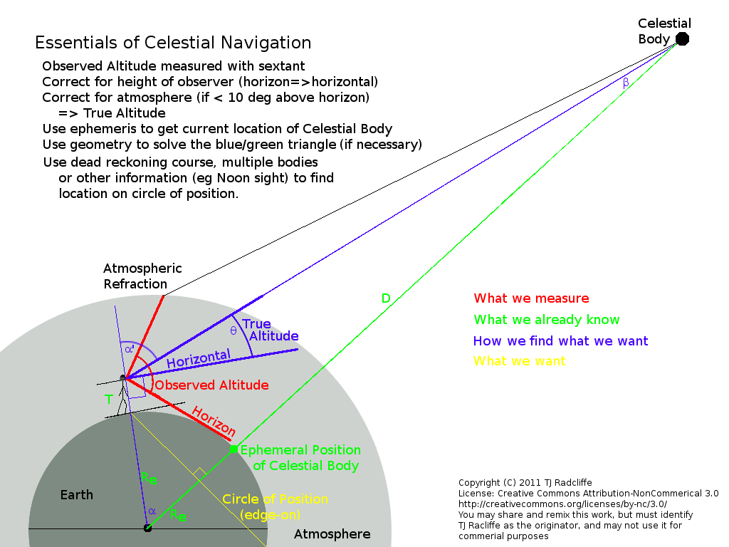
What we measure, know, find , want

Slide 21
What we measure, know, find , want
DIP

Slide 22
Corrections
Main Corrections
  DIP
    Height of eye (HE)
  Refraction
  Semi Diameter
    upper limb
    lower limb
Temperature, Barometric
  only required when bodies < 15°
Lunar Parallax
Notes:
DIP – always subtract
Refraction (add temp and baro corrections for low sights)
Diff between UL and LL of the sun 15’ 45” (old school – 15.75 is what all the kids would use)

Slide 23
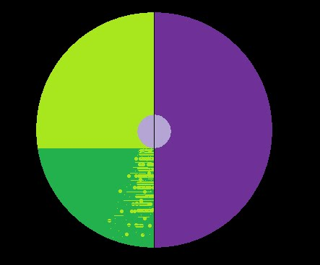
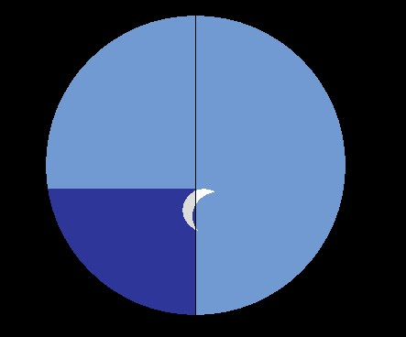
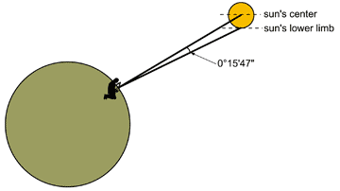
Corrections
Main Corrections
  DIP
    Height of eye (HE)
  Refraction
  Semi Diameter
    upper limb
    lower limb
Temperature, Barometric
  only for low angles
Lunar Parallax
Notes:
DIP – always subtract
Refraction (add temp and baro corrections for low sights)
Diff between UL and LL of the sun 15’ 45” (old school – 15.75 is what all the kids would use)

Slide 24
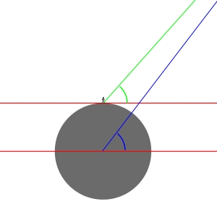
Lunar Parallax
Geodetic horizon
Celestial horizon
Notes:
I will not go into this other than to mention it exists

Slide 25
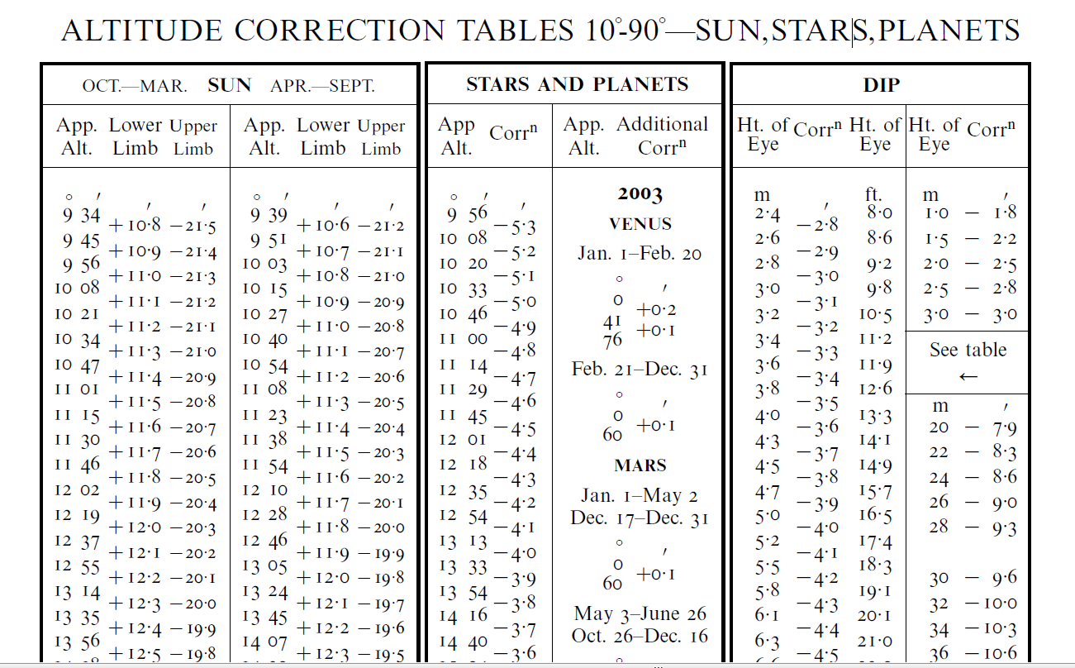
Main Corrections – table A2
SUN Stars Planets DIP
Refraction + Semi-diameter Refraction height of eye (HE)
Notes:
HANDOUT –never changes (except for planets), sun has separate corrections for Winter and Summer

Slide 26
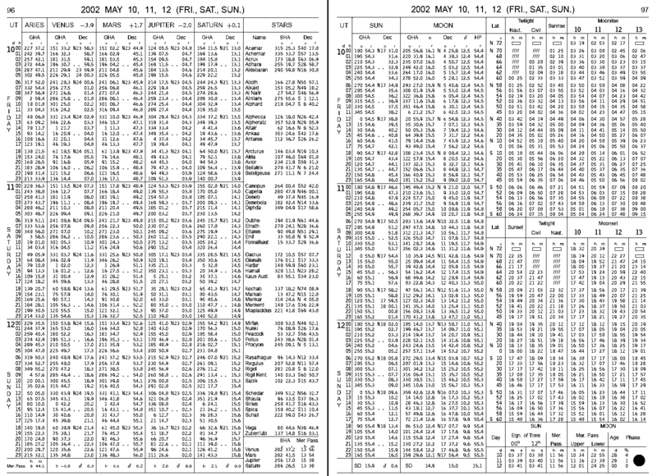
Ephemeris - the Nautical Almanac for 3 days on 2 pages
Notes:
NA = Ephemersis - 3 days of data on two facing pages for Sun, Moon, 4 planets, and 58 stars
HANDOUT – is very similar, but for the current sky right now
I like because it’s very close to Nautical Almanac (missing twilights)
ephemeral : data will never again be valid

Slide 27
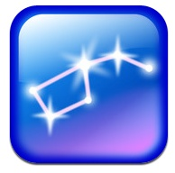
Star Finder
Mechanical disks
  Similux HO 2102-D modified Rude and Collins
Flexible Domes
Star Walk
  “must have” app
  bargain at $2.99 on iTunes

Slide 28
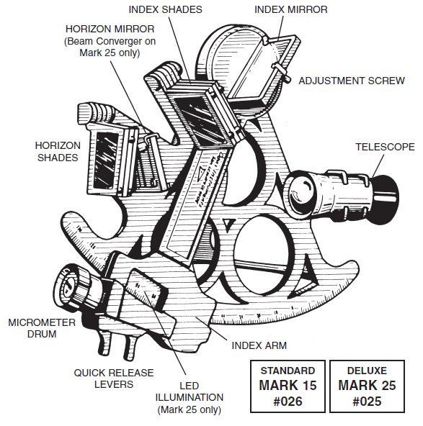
Sextant intro
Delicate instrument
Hold only by
frame or handle

Slide 29
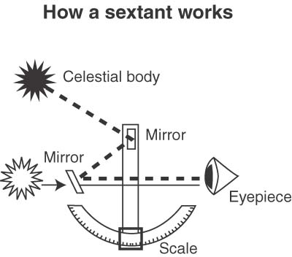
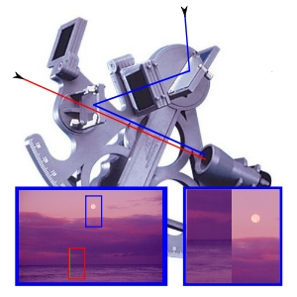
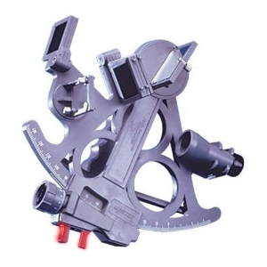
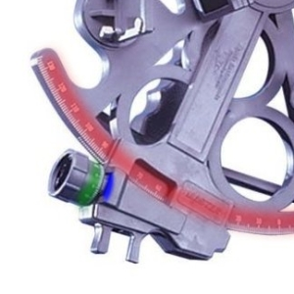
How a sextant works

Slide 30
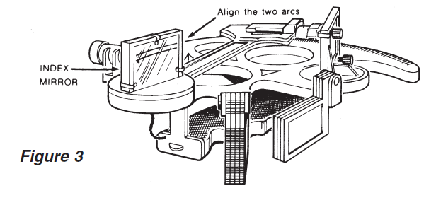
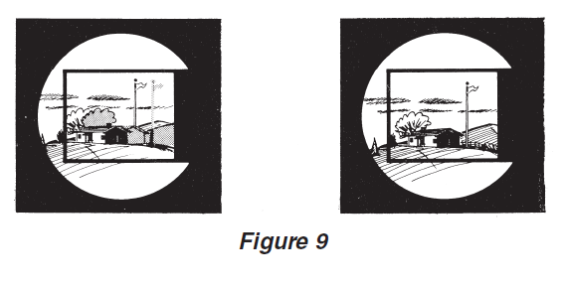
Sextant Adjustment & Calibration
Adjust Index mirror
set to aprox 45-55 degrees
2. Adjust Horizon mirror
set to 0 degrees
3. Measure residual Index error (IC)
sight a distant start

Slide 31
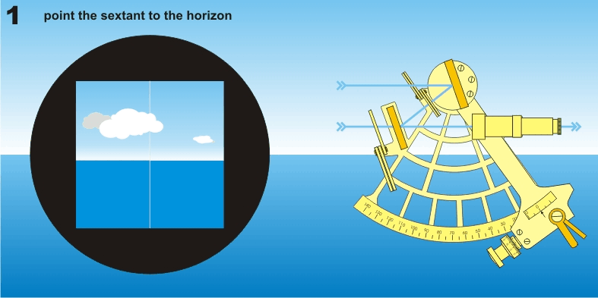
Sextant – 6 steps
Point at horizon
Press clamp to release
Bring sun into view
4. Release clamp, adjust venier drum
5. Rock sextant for vertical, readjust
6. Read angle

Slide 32
Practical Sextant Tips
Avoid shots > 75°
  Difficult to find vertical, as rocking
  gives very flat swing of the body
Avoid shots < 15 °
  requires temp and baro corrections
Daylight
  Sun, Moon
  Bring horizon up to the sun
Twilight
  Star, Planets
After Dark
  Nautical sextants useless
  Use bubble sextants

Slide 33
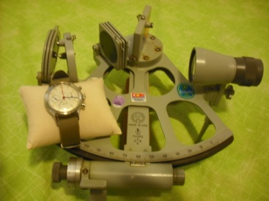
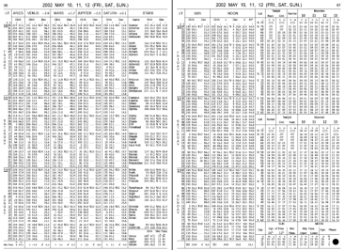
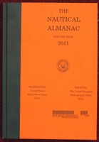
Sight Reduction
Inputs
Altitude (sextant)
GMT (chronometer)
Ephemeris for today
Dead Reckoning (DR)
position (lat, long)
Output (FIX)
Azimuth (bearing true)
Intercept (range)
Ageton Method
  one small volume
  for all latitudes, altitudes and declinations
  requires 45min with paper and pencil
Pub 229 – mariners
  six volumes by latitude
Pub 249 - aviators
  faster, less accurate
  3 volumes, spiral bound
  limited # stars and latitudes
  must replace every 5-8 years
Weems
  Graphical, even less accurate
Calculator
  programmable trig calculators
Purpose-built
  Hinzite
  iPod/iPad/iPhone
    Combines sextant, chrono, ephemeris
    Rapid mapping
    No Cellular or WiFi required
    free to $5

Slide 34
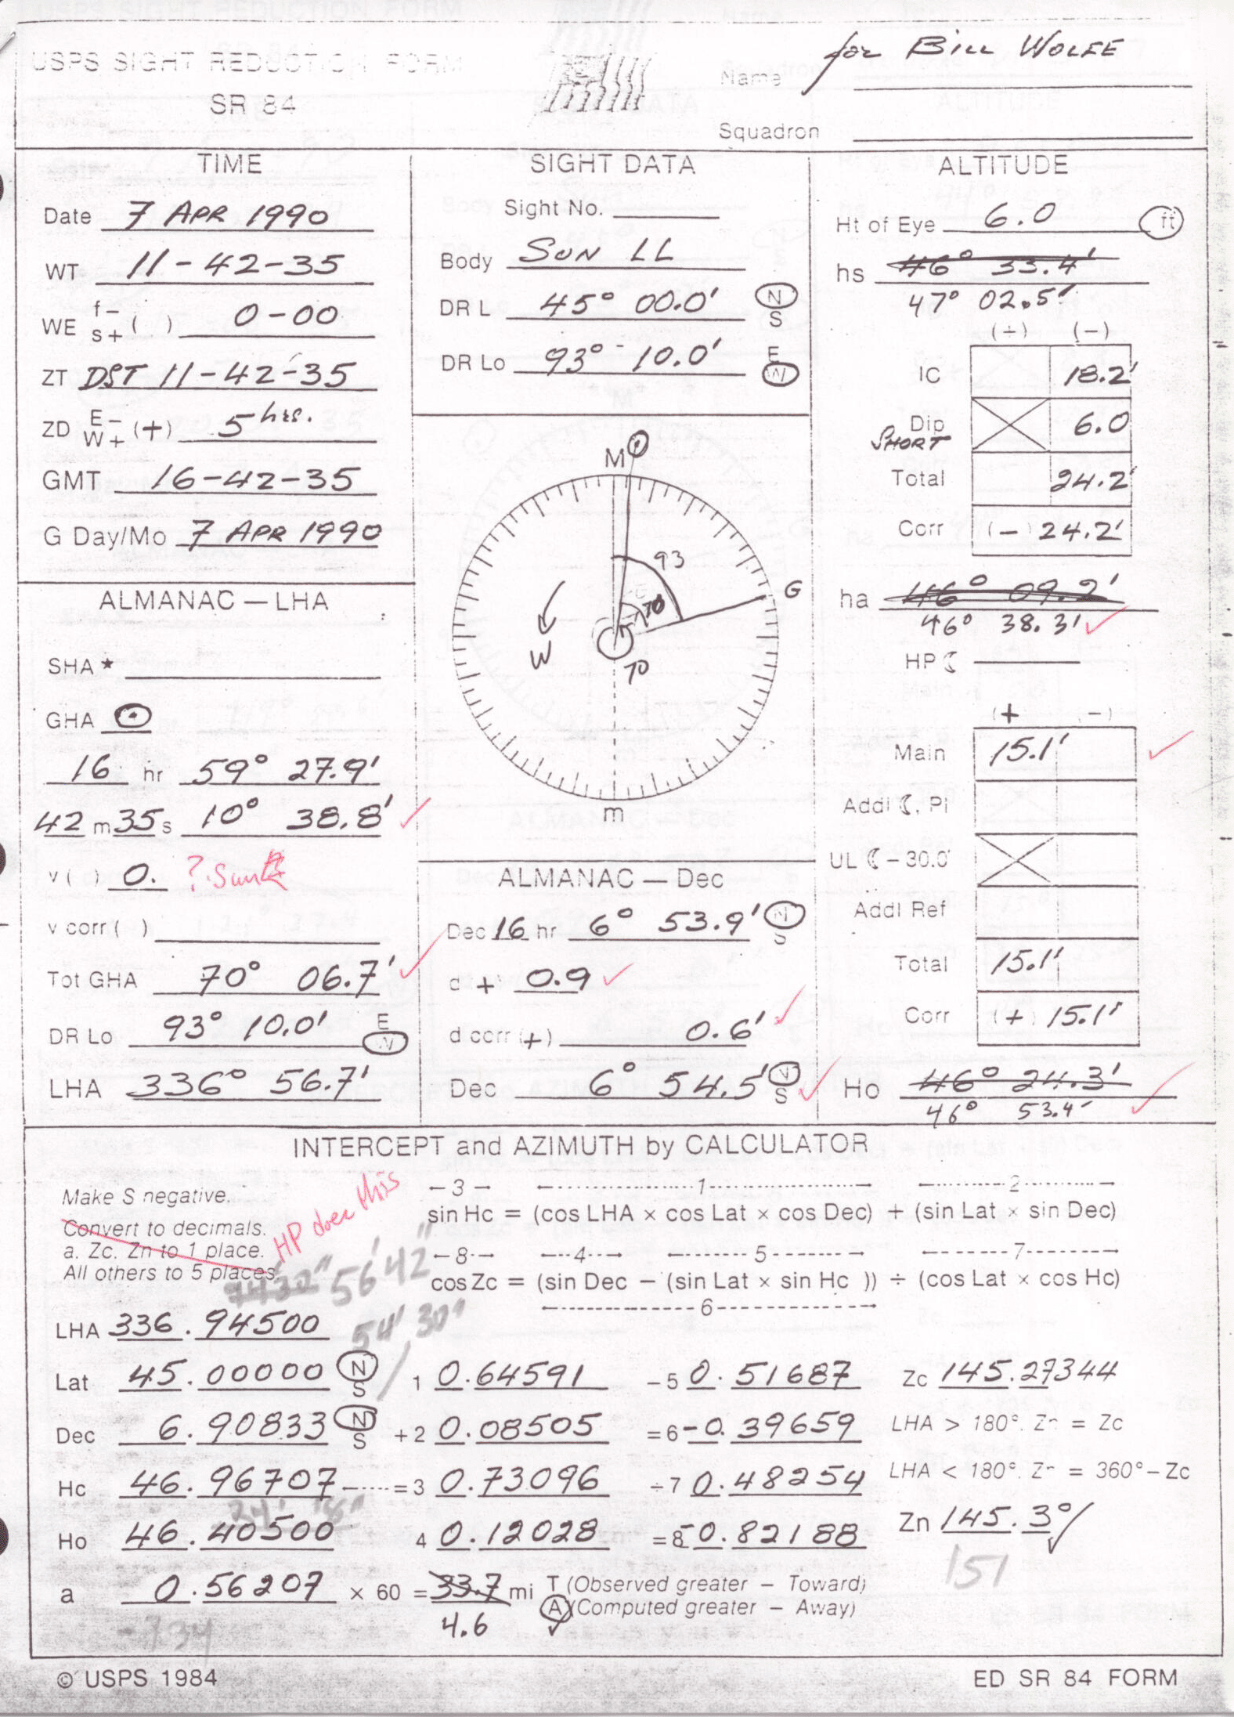
Example
SR84
Notes:
HANDOUT -

Slide 35
Time & Sight
Notes:
HANDOUT -

Slide 36
Sextant & Corrections
Notes:
HANDOUT -

Slide 37
Almanac
Notes:
HANDOUT -

Slide 38
Intercept and Azimuth by Calculaotr
Notes:
HANDOUT -

Slide 39
Today’s Almanac
  GHA
  Dec
  d
Notes:
HANDOUT -

Slide 40
Sextant data and corrections
hs
IC
DIP
ha
Main Correction
Ho
Notes:
HANDOUT -

Slide 41
Intercept (a) and Azimuth (Zn) by Calculator
Lat
Inputs
  LHA = GHA - Long (west)
  LHA = GHA + Long (east)
  Lat = DR Lat
  Dec = almanac’s value
  Ho = height observed
  (after corrections)
LHA
  Dec
Ho
Outputs
Zn = bearing to GP
a = nautical miles to/away
Notes:
HANDOUT -

Slide 42
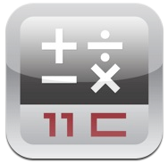
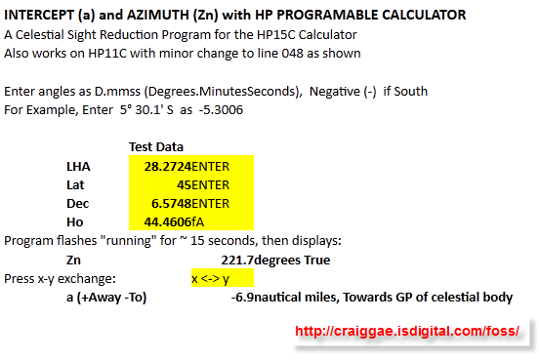
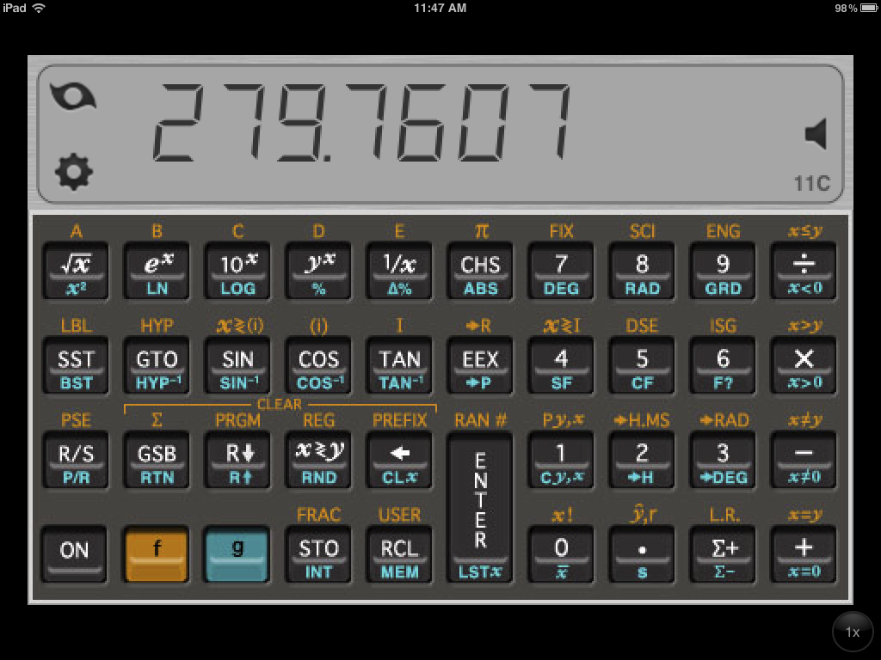
Program for HP Calculator
Free, GPL licensed, at http://craiggae.isdigital.com/
Calc 11C $0.99 on iTunes
Notes:
I wrote code of HP programmable calculator
You can download from my web site

Slide 43
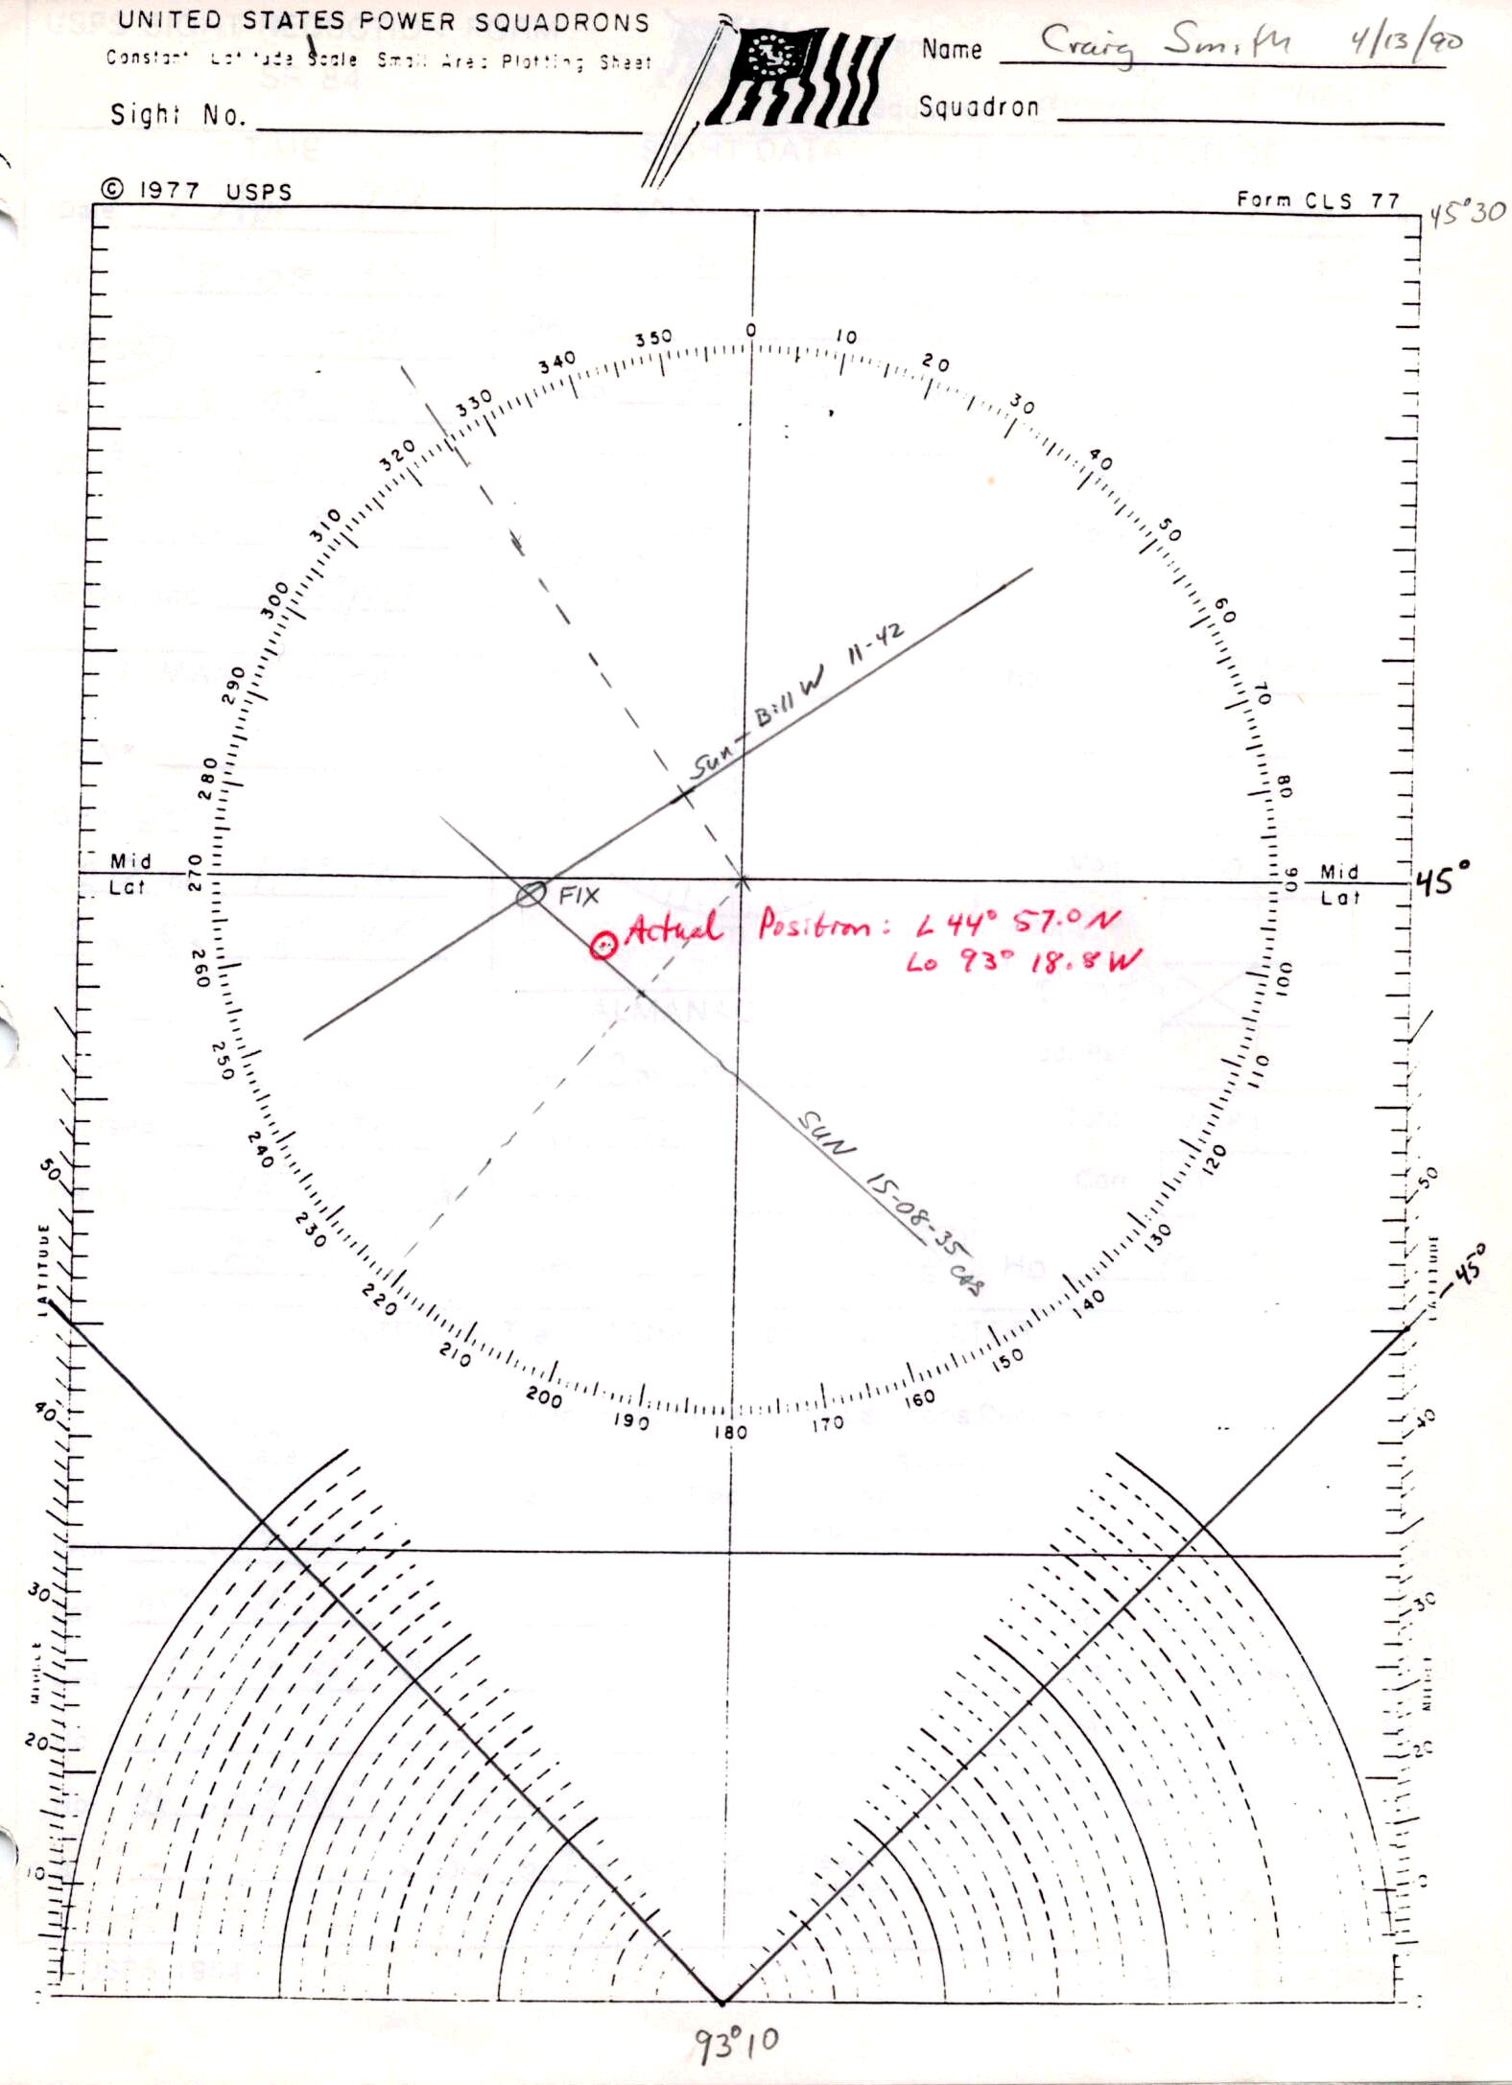
Two body FIX vs Surveyed location
DR
45° 00’ N
93 ° 10’ W
Construction lines
Draw Longitudes
Plot LOP Sun
  Morning
  Afternoon
FIX
US Geo Survey
  north shore Lake Calhoun
92° 25’
93° 55’
93° 10’
Notes:
Maneuvering board – think about navigating on water world – no land features

Slide 44
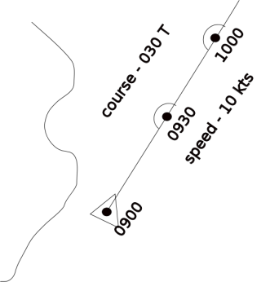
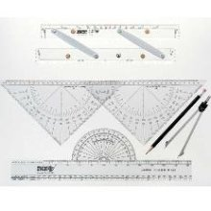
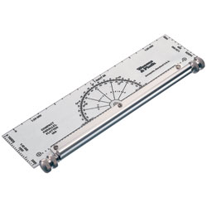
Navigational Plotting
Paper and pencil
between fixes

Slide 45
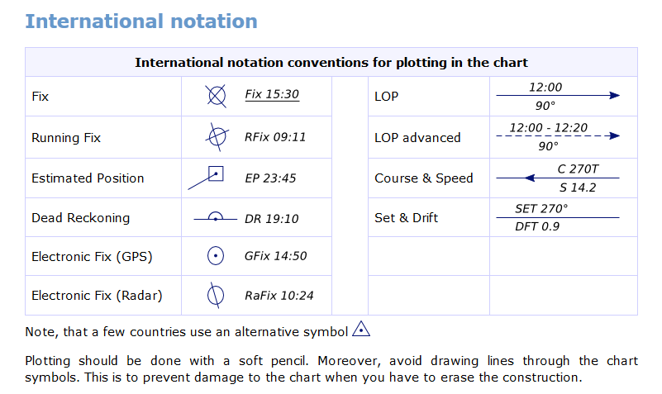
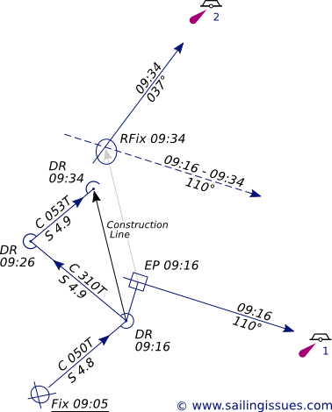
Plotting course & speed,
DR, EP, Running Fix

Slide 46
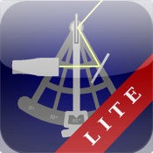
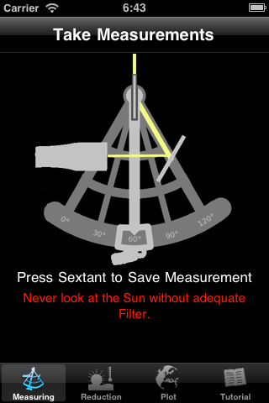
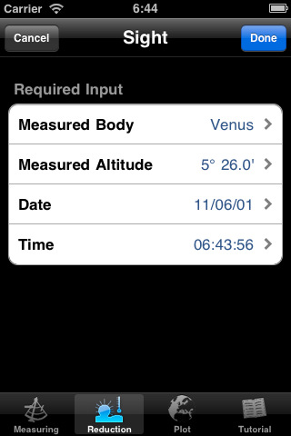
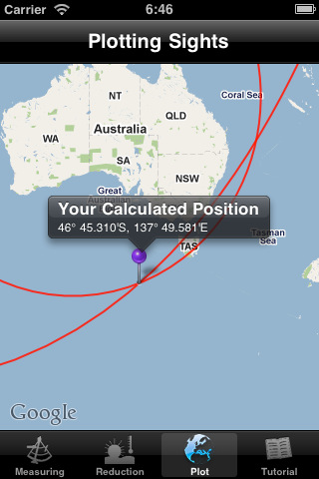
AstroNav Lite by Sascha Troscheit
All you need is the Sun, star, or planet, and a steady hand.
Use inbuilt sextant for accuracy to within a degree, good enough for FIX within 60 miles.
Or use to reduce sights from a commercial sextant for positions to within a mile.
Features
-Inbuilt sextant (Calibration only in full version)
-Sight Reduction with Sun, Venus and 12 stars (56 stars, Moon, and 4 planets in full version)
-A map to display your intercept.
-A tutorial to get you started.
Lite version limited to 3 sights at a time. No calibration. Data and algorithms are not as accurate as the $4 full version.
Notes:
If you don’t have an iPhone, iPad, or iPod touch, I have 5 your can try

Slide 47
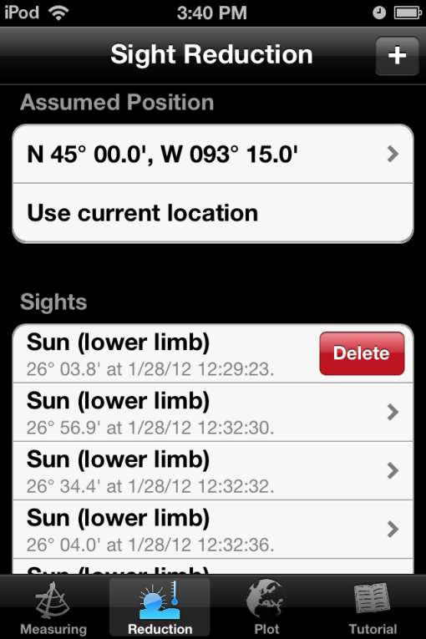
Using Astro Nav
Enter assumed position
Delete previous sights
Find star, aim, tap
Take multiple sights
(3 max with free version)
Reduction – id body
Check Plot

Slide 48
Using Astro Nav
Enter assumed position
Delete previous sights
Find star, aim, tap
Take multiple sights
(3 max with free version)
Reduction – id body
Check Plot

Slide 49
Using Astro Nav
Enter assumed position
Delete previous sights
Find star, aim, tap
Take multiple sights
(3 max with free version)
Reduction – id body
Check Plot

Slide 50

Using Astro Nav
Enter assumed position
Delete previous sights
Find star, aim, tap
Take multiple sights
(3 max with free version)
Reduction – id body
Check Plot

Slide 51

Orion
Star Walk app - $2.99 on iTunes

Slide 52

Taurus

Slide 53

Gemini

Slide 54

Let’s Try
Intermission
Q&A
Lifeboat navigation
Reduce sights
  calculator
  or Pub 229

Slide 55
Intermission
http://vimeo.com/36141149

Slide 56

In case of clouds

Slide 57
In case of clouds
Use altitude of Sirius
from Star Walk
27° 29’ 49” (27° 29.8’)

Slide 58
Options
  AstroNav
  Tilt, record as Sirius
  Compare LOP with DR
Form SR96a (HANDOUT)
  Altitude from Star Walk
  LHA, Dec from Nautical Almanac (HANDOUT)
  Reduce (calculator or Pub 229)
  Plot on CLS98 (HANDOUT)

Slide 59

Star Walk Sirius

Slide 60

Sirius – altitude form Star Walk

Slide 61

Star Walk Lat/Long

Slide 62

SR 96a

Slide 63
SR 96a input data
Feb 23
20^{h} 00^{m}
Sirius
45° 0.0’
20^{h} 00^{m}
93° 15.0’
+ 6^{h}
2^{h} 00^{m}
Feb 24
G
27° 29.8’

Slide 64
SR 96a + almanac data
Feb 23
20^{h} 00^{m}
Sirius
45° 0.0’
20^{h} 00^{m}
93° 15.0’
+ 6^{h}
★
2^{h} 00^{m}
Feb 24

258° 34.3’
G

2^{h}
183° 22.3’
0^{m}
-0-
-0-
183° 22.3’
-
93° 15.0’
348° 41.6’
16° 44.3’
27° 29.8’

Slide 65

Calculator Reduction
348° 41.6’
45° 0.0’
16° 44.3’
27° 29.8’

Slide 66
Calculator Reduction
348° 41.6’
348.6933°
45° 0.0’
45.0000°
16° 44.3’
-
16.7383°
27.4102°
168°
27° 24.6’
27° 29.8’
-5.3

Slide 67

CLS98
AP
45°
168°

Slide 68
CLS98
45°
5.3 nm

Slide 69
CLS98
AP
45°
Fix

Slide 70
CLS98
AP
45°
44° 55’
Fix

Slide 71
Life Boat Navigation
Missing 1 or more
  Sextant
  Chronometer
  Ephemeris
  Reduction method
Notes:
No sextant – horizon or zenith sights
WE unknown – relative change in longitude
No chrono – Lunar method to measure GMT
No ephmersis – alalema
No calculator – Ageton or Weems methods

Slide 72


Analemma

